Slide 1
Data Analysis on IPL Most Runs Per Over
Source: https://drive.google.com/file/d/19fL5pxaz4ouAFGxuW0Uu4EO-ICAbvQTN/view?usp=sharing
Dataset: IPL Most Runs Per Over-All Seasons Combined.csv
📩 Email: maheshpothu7@gmail.com
📞 Phone: 9177462982
LinkedIn: www.linkedin.com/in/p-mahesh-3a64672a4

Slide 2
INITIAL ANALYSIS OF THE DATASET
The dataset contains a total of 2100 entries.
It highlights the most aggressive batting overs in IPL history, sorted by runs scored, balls faced, and strike rate.
The best performance listed belongs to players who scored 36 runs in a single over, including Chris Gayle and Ravindra Jadeja.
The second-best entries feature overs of 30–34 runs, achieved by power-hitters such as AB de Villiers, Virender Sehwag, and Kieron Pollard.
Other notable high-scoring overs in the dataset include contributions from Shane Watson, Andre Russell, and MS Dhoni, with several of these coming in batting-friendly venues like the M. Chinnaswamy Stadium and Wankhede Stadium.

Slide 3
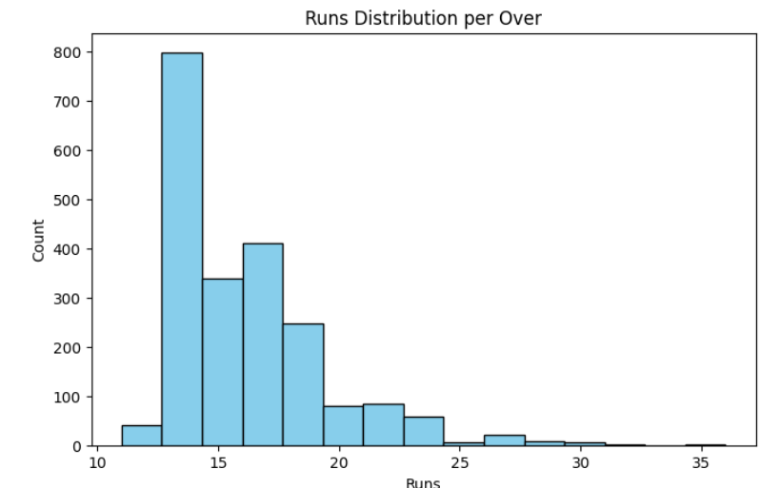
Runs Distribution per Over
While a few players have produced explosive overs of 30+ runs, the majority of overs cluster in the 14–18 run range, making it the most common scoring bracket.
For consistency, this indicates that while big overs grab attention, steady mid-range scoring overs occur far more frequently across IPL seasons.

Slide 4
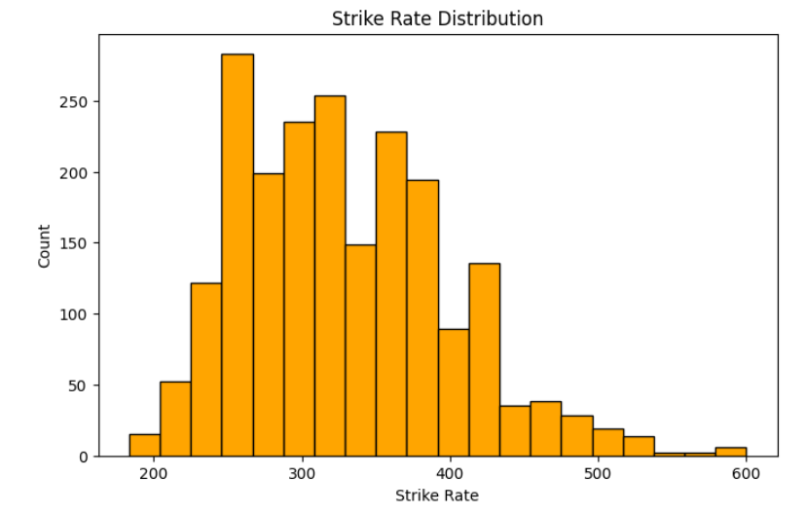
Strike Rate Distribution
While a few overs record extraordinary strike rates above 500, the majority of overs fall within the 280–360 range, making it the most consistent scoring zone.
For consistency, this shows that although explosive strike rates exist, most players deliver impactful overs within this stable range.

Slide 5
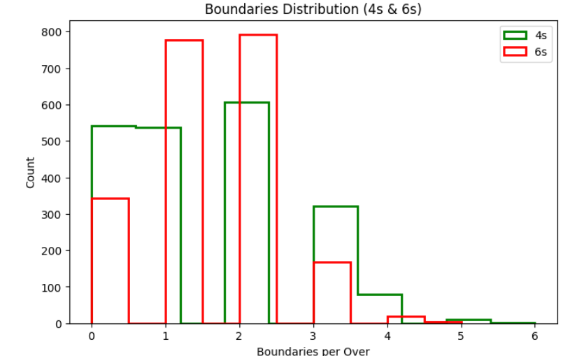
Boundaries Distribution (4s&6s)
While some overs feature as many as 5–6 boundaries, most overs typically include only 1–2 fours or sixes, making them the most common outcomes.
For consistency, this shows that big-hitting overs are rare, while smaller contributions of boundaries occur much more frequently across the dataset.

Slide 6
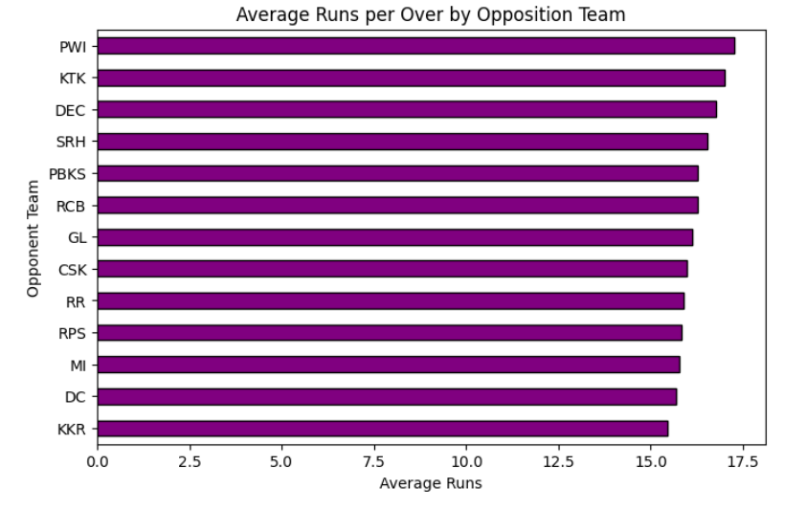
Average Runs per Over by Opposition Team
While some teams concede an average of 18+ runs per over, most opponents restrict scoring to around 15–16 runs, showing tighter bowling control.
For consistency, this highlights that certain teams are more vulnerable to high-scoring overs, while others maintain greater discipline across seasons.

Slide 7
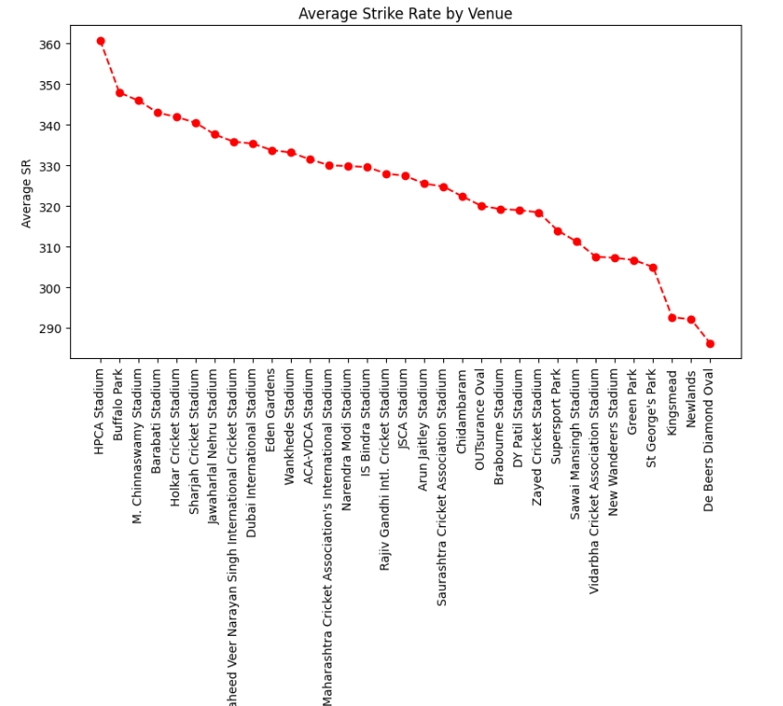
Average Strike Rate By Venue
While a few venues record average strike rates above 360, most stadiums maintain scoring rates in the 300–340 range, reflecting balanced batting conditions.
For consistency, this indicates that batting-friendly grounds like the M. Chinnaswamy Stadium and Wankhede Stadium stand out, while others offer more controlled scoring environments.

Slide 8
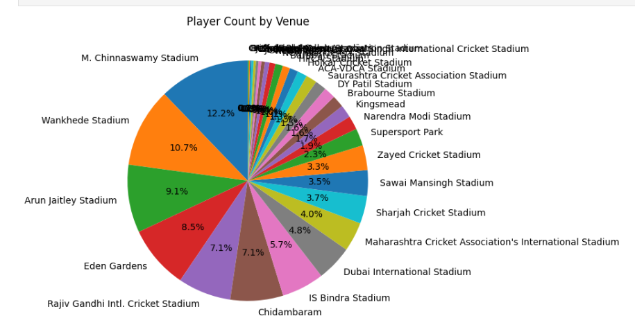
Player Count by Venue
This pie chart shows the distribution of players across different venues.
Each slice represents a venue, and its size indicates the proportion of players who have played there.

Slide 9
Conclusion
This project successfully analyzed IPL batting performance on a per-over basis, using runs, strike rate, and boundaries as the key metrics, leveraging Big Data Analytics techniques with tools like Python (Pandas & Matplotlib) and PySpark.
The analysis identified the most explosive overs, consistently high-scoring players, and variations in runs and strike rates across different venues and against various opponents.
Key findings show that while a few overs achieve extraordinary runs or strike rates, the majority of overs cluster in stable mid-range scoring zones, and venues and opposition teams influence performance patterns.
The project demonstrates the power of data analytics in cricket, providing actionable insights for coaches, analysts, and fans to understand scoring trends, player efficiency, and venue impacts.

